Slide 1
International Islamic University Chittagong Department of Computer Science & Engineering
Course Code: CSE-2430
Course Title: Competitive Programming II
Fathema Tuj Johora
Adjunct faculty, Dept. of CSE, IIUC

Slide 2
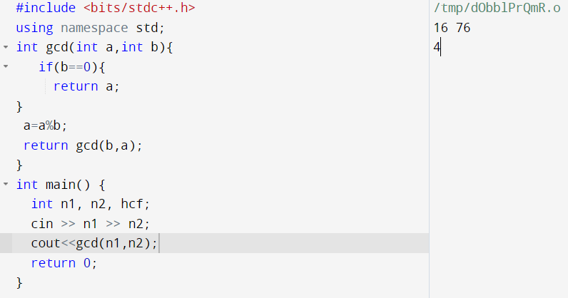
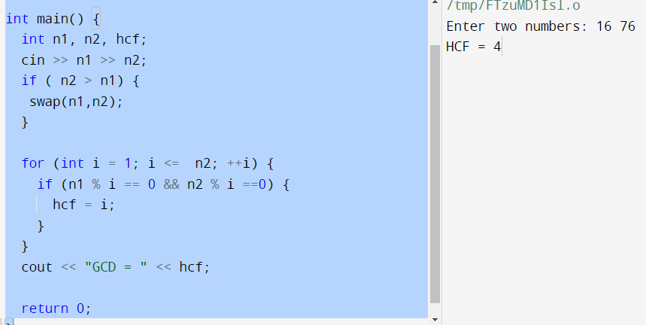
Number Theory
GCD: O(log(min(a,b)))
GCD: O(min(n1, n2))

Slide 3
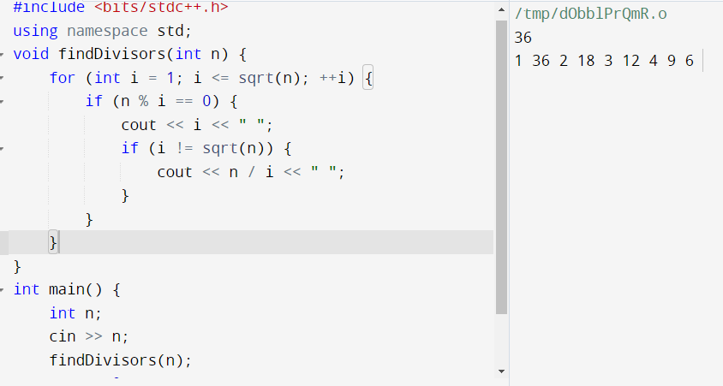
Divisor
Finding Divisors in O(sqrt(n)) Time Complexity

Slide 4
Fibonacci

Slide 5
Prime
Prime Number Generation O(n^2)
void generatePrimes(int n) {
for (int i = 2; i <= n; ++i) {
if (isPrime(i)) {
cout << i << " ";
}
}
}
int main() {
int n;
cin >> n;
generatePrimes(n);
return 0;
}
bool isPrime(int num) {
if (num <= 1)
return false;
for (int i = 2; i < num; ++i) {
if (num % i == 0) {
return false;
}
}
return true;
}

Slide 6
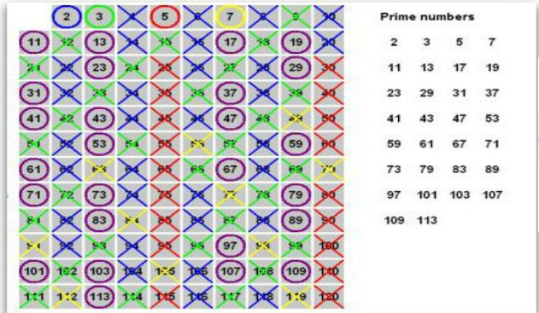
Sieve of Eratosthenes O(n*log(log(n)))
The Sieve of Eratosthenes is a much more efficient algorithm for generating prime numbers compared to the O(n^2) approach. It has a time complexity of O(n*log(log(n)))

Slide 7
#include <bits/stdc++.h>
using namespace std;
void SOE(int n) {
vector<bool> isPrime(n + 1, true);
for (int p = 2; p * p <= n; ++p) {
if (isPrime[p]) {
for (int i = p * p; i <= n; i += p) {
isPrime[i] = false;
}
}
}
for (int p = 2; p <= n; ++p) {
if (isPrime[p]) {
cout << p << " ";
}
}
}
int main() {
int n;
cin >> n;
SOE(n);
return 0;
}

Slide 8
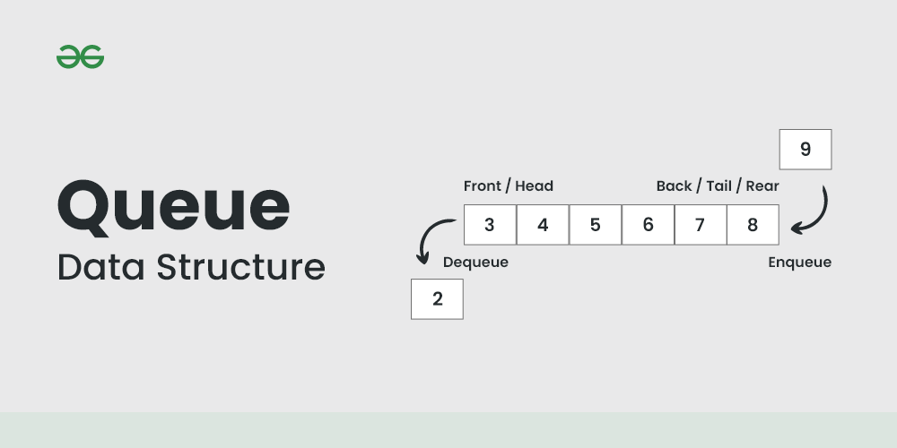

Slide 9
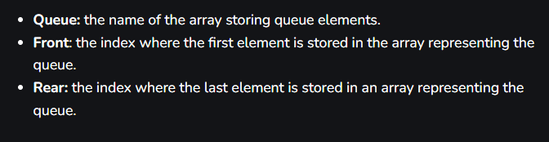
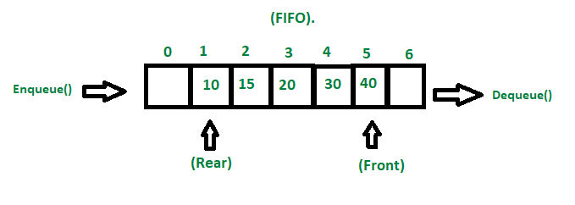

Slide 10
FIFO Principle of Queue:
A Queue is like a line waiting to purchase tickets, where the first person in line is the first person served. (i.e. First come first serve).
Position of the entry in a queue ready to be served, that is, the first entry that will be removed from the queue, is called the front of the queue(sometimes, head of the queue), similarly, the position of the last entry in the queue, that is, the one most recently added, is called the rear (or the tail) of the queue. See the below figure.

Slide 11
Queue Data Structure using Arrays
Head: the front position of the queue
Tail: The last position of the queue
Disadvantages: size is fixed;
wastage of memory

Slide 12
Queue Data Structure using Linked List
No fixed Size
Can be removed the tail from the memory, no wastage memory

Slide 13
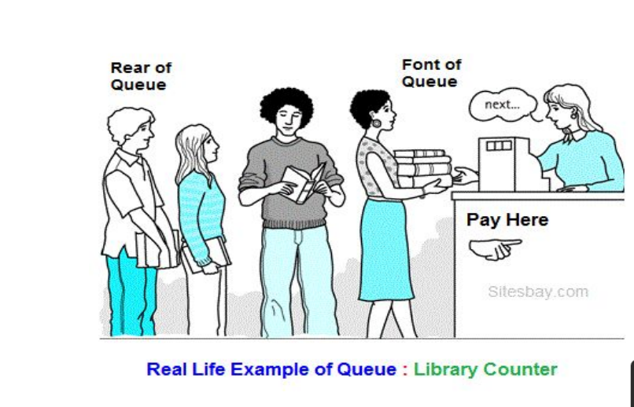

Slide 14
queue< int > q;
q.push( 100 ); // inserting 100
q.push( 101 ); // inserting 101
q.push( 102 ); // inserting 102
while( !q.empty() ) {
cout << q.front() << endl; // printing the front
q.pop(); // removing that one
}
QUEUEEZ - Easy Queue
Link: https://www.spoj.com/problems/QUEUEEZ/
Input: 6 1 5 1 6 2 3 2 3 Output: 6 Empty!

Slide 15
Problems…
12100 Printer Queue
QUEUEEZ- Easy Queue

Slide 16
Priority Queue
A priority queue is a type of queue that arranges elements based on their priority values. Elements with higher priority values are typically retrieved before elements with lower priority values.
Syntax:
priority_queue< int > q; (Max Heap)
priority_queue <int, vector<int>, greater<int>> gq; (Min Heap)

Slide 17
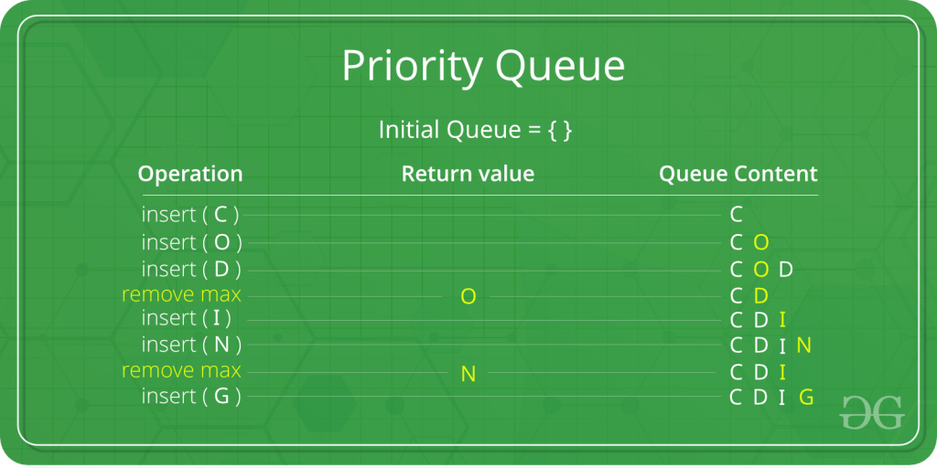

Slide 18


Slide 19
#include <iostream>
#include <queue>
using namespace std;
int main()
{
int arr[6] = { 10, 2, 4, 8, 6, 9 };
priority_queue<int> pq;
// printing array
cout << "Array: ";
for (auto i : arr) {
cout << i << ' ';
}
cout << endl;
// pushing array sequentially one by one
for (int i = 0; i < 6; i++) {
pq.push(arr[i]);
}
// printing priority queue
cout << "Priority Queue: ";
while (!pq.empty()) {
cout << pq.top() << ' ';
pq.pop();
}
return 0;
}

Slide 20
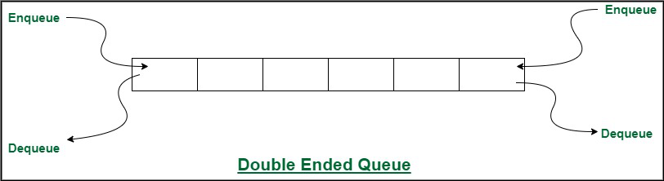
Dequeue
Deque is a data structure that inherits the properties of both queues and stacks. Additionally, the implementation of this data structure requires constant time, i.e., time complexity = O(1). This means you can use deque to your advantage to implement both the queue and stack.

Slide 21
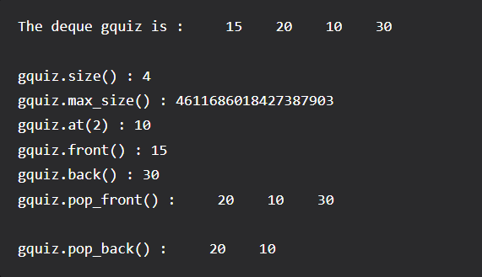
#include<bits/stdc++.h>
using namespace std;
void showdq(deque<int> g)
{
deque<int>::iterator it;
for (it = g.begin(); it != g.end(); ++it)
cout << '\t' << *it;
cout << '\n';
}
int main()
{
deque<int> gquiz;
gquiz.push_back(10);
gquiz.push_front(20);
gquiz.push_back(30);
gquiz.push_front(15);
cout << "The deque gquiz is : ";
showdq(gquiz);
cout << "\ngquiz.size() : " << gquiz.size();
cout << "\ngquiz.max_size() : " << gquiz.max_size();
cout << "\ngquiz.at(2) : " << gquiz.at(2);
cout << "\ngquiz.front() : " << gquiz.front();
cout << "\ngquiz.back() : " << gquiz.back();
cout << "\ngquiz.pop_front() : ";
gquiz.pop_front();
showdq(gquiz);
cout << "\ngquiz.pop_back() : ";
gquiz.pop_back();
showdq(gquiz);
return 0;
}

Slide 22
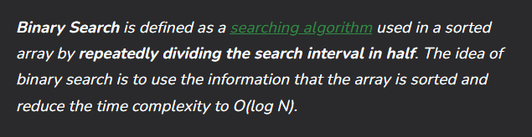
Binary Search…

Slide 23
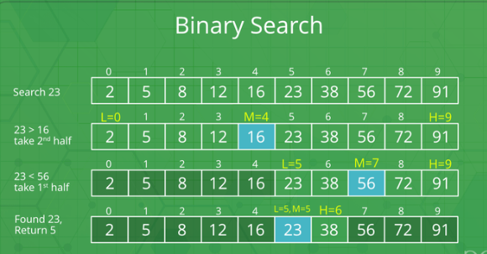
Conditions for when to apply Binary Search in a Data Structure:
To apply Binary Search algorithm:
The data structure must be sorted.
Access to any element of the data structure takes constant time.

Slide 24
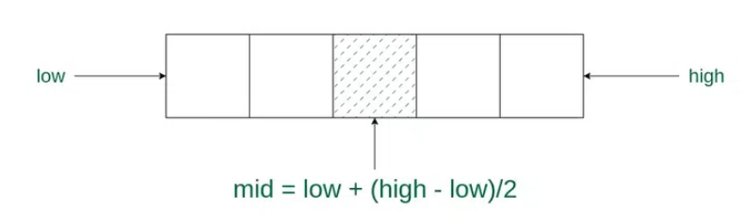
Binary Search Algorithm:
Divide the search space into two halves by finding the middle index “mid”.
Compare the middle element of the search space with the key.
If the key is found at middle element, the process is terminated.
If the key is not found at middle element, choose which half will be used as the next search space.
If the key is smaller than the middle element, then the left side is used for next search.
If the key is larger than the middle element, then the right side is used for next search.
This process is continued until the key is found or the total search space is exhausted.

Slide 25
The Binary Search Algorithm can be implemented in the following two ways
Iterative Binary Search Algorithm
Recursive Binary Search Algorithm

Slide 26
The Binary Search Algorithm can be implemented in the following two ways : Iterative Binary Search Algorithm Recursive Binary Search Algorithm
#include <bits/stdc++.h>
using namespace std;
int binarySearch(int arr[], int l, int r, int x)
{
while (l <= r) {
int m = l + (r - l) / 2;
if (arr[m] == x)
return m;
if (arr[m] < x)
l = m + 1;
else
r = m - 1;
}
// If we reach here, then element was not present
return -1;
}
// Driver code
int main(void)
{
int arr[] = { 2, 3, 4, 10, 40 };
int x = 10;
int n = sizeof(arr) / sizeof(arr[0]);
int result = binarySearch(arr, 0, n - 1, x);
(result == -1)
? cout << "Element is not present in array"
: cout << "Element is present at index " << result;
return 0;
}

Slide 27
In STL…
Binary search function:
sort(arr,arr+n);
bool f=binary_search(arr,arr+n,20);
cout<<f<<endl;

Slide 28
Problems…
https://codeforces.com/problemset/problem/1436/C

